Slide 1
Top 10 Cities for BBQ
Andrea Burson
Caleb Sherry
Chris Rettig
Dustin Elery
Emily Cruz

Slide 2
BBQ Restaurateurs
A BBQ franchise wants to establish a new restaurant in a large metropolis.
The owners have reached out to our team to review the BBQ restaurants and their ratings in the vicinity as well as the demographics of the people living in that area.

Slide 3
Motivation and Summary
Hopper Media identified the ten best cities for BBQ in the United States
Our intent is to use the CityGrid and Google APIs to identify the restaurants and reviews in those cities and determine if the data corroborates that article.

Slide 4
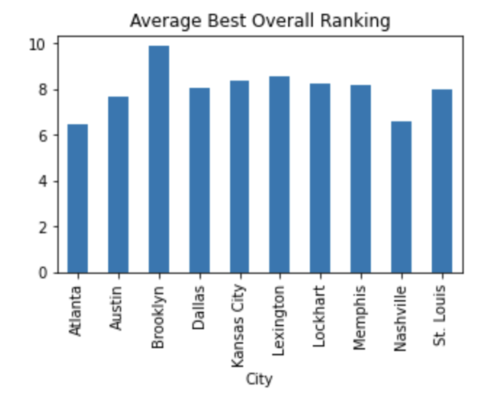
Question 1
What is the average ranking of BBQ restaurants the 10 top cities identified from Hopper Media from the CityGrid API?

Slide 5
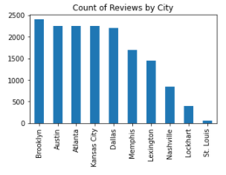
Question 2
What city has the largest amount of reviews for BBQ restaurants?

Slide 6
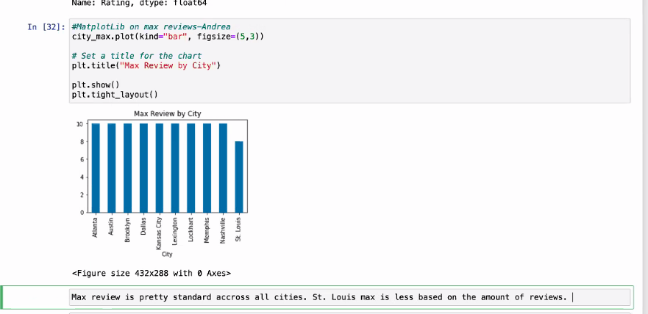
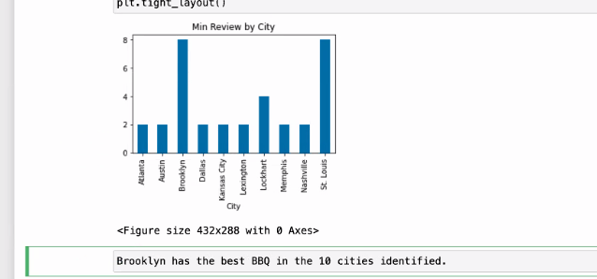
Question 3 & 4
What city had the lowest and highest rating overall?

Slide 7
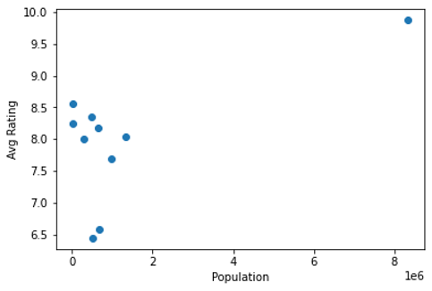
Question 5
Do we see any correlation between rankings and any demographics?
Looking at the scatterplot, we do not see any obvious visual correlation between data frames.

Slide 8
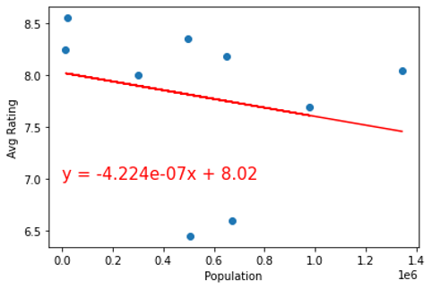
MatPlotLib – Question 5
We then plot a linear regression within the merged data frames (while deleting the outlier)
Conclude that the two data frames do not correlate due to the practically zero slope and low R squared value
Slope of the line is deceiving in the image due to the population scale on the x-axis

Slide 9
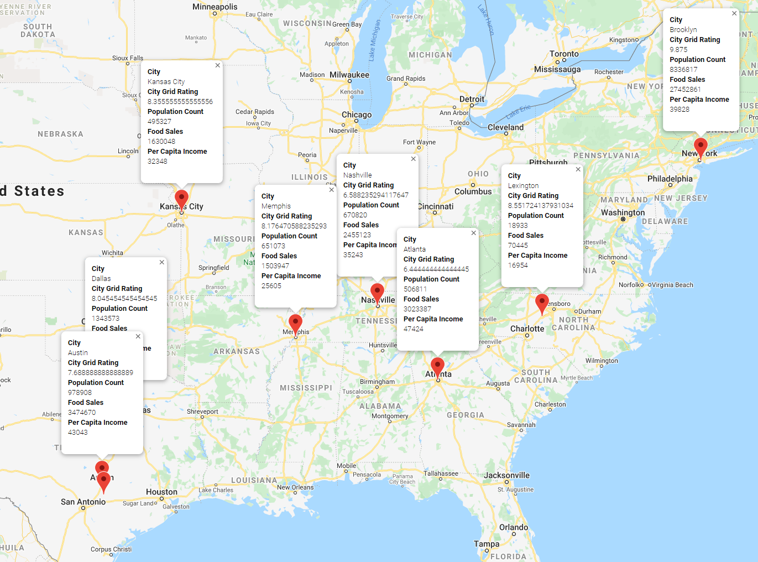
Map
The 10 cities ranged from Brooklyn, NY to Austin, TX.
The map displays:
physical location of the city
the average CityGrid rating for that city
the population count, food sales, and per capita income.

Slide 10

API and Data Description: CityGrid
“CityGrid is an API suite providing local content for over 18 million businesses.”
It is comprised of three API’s: Places API, Offers API, and Reviews API
We used the Reviews API and then Places API in our analysis
“The Places API provides functionality for information on local businesses, including search, detail, user content submission, and predictive text.
The Reviews API provides access to customer reviews for businesses selected by id or by geography or category.”
We used the Reviews API to pull back our review data by city as a reviewer level of cardinality. We then used the business under reviews ID to call the Places API to get back the city, state, and zip code for each business
Some data validity concerns were found when exploring the data in Andrea’s analysis. If more time allowed, we would deep dive into the raw row level data to assess the reliability across each city

Slide 11

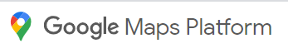
API and Data Description: Census and Google
US Census Bureau QuickFacts - selected cities demographics. Downloaded to csv and cleaned.
Google Place Search API - to pull in longitude and latitude for selected cities

Slide 12
Anova Findings-Dustin
Are any of the average ratings statistically different from each other across cities?
Null Hypothesis: All averages are equal
Alternate: At least two groups in the group are not
Results for all 10 citys: F_onewayResult(statistic=390.41093032048053, pvalue=0.0)
Results for only Lockhart, Atlanta, and Austin: F_onewayResult(statistic=160.09460510698491, pvalue=4.470698236617927e-68)
Result: Given the p-value is <.05, we can reject the null and accept the alternate that at least two groups have significantly different averages

Slide 13
Summary of Analysis
Outcomes:
Brooklyn has the best average ratings and the most reviews
depending on the strategy this may or may not be the best metropolis
There is no correlation between population size and average rating scores
There doesn’t appear to be any West Coast representation in the top 10
The averages appear to be statistically different and reliable for our use case
Observations/Improvement Opportunities:
Our review data source may not be fully reliable across cities. More time to dive into the raw data would help.
Also, consider reviewing more summary statistics on the raw data sets
We could add in other review data sources such as Yelp
The census data did not have demographic information for just Brooklyn, using NY as a proxy (as expected) doesn’t work. Ideally, we would find a reliable source for this as well
ANOVA follow up testing to make sure each group was statistically different in their averages, if that was deemed critical to a final outcome.

Slide 14

Questions

Slide 15
References
Hopper Editors. (10/26/2017). The Ten Best Cities for BBQ in the United States. https://media.hopper.com/articles/the-ten-best-cities-for-bbq-in-the-united-states
US Census Bureau QuickFacts- www.census.gov/quickfacts
Google Developers - developers.google.com/places/web-service/search
Anova Information - https://statistics.laerd.com/statistical-guides/one-way-anova-statistical-guide.php
CityGrid API Documentation - https://citygridmedia.atlassian.net/wiki/spaces/citygridv2/pages/4980758/Content+by+CityGrid

